Slide 1
PROPERTY LIST MANAGER
GROUP NO:07

Slide 2

What is Property List Manager?
The Property List Manager facilitates to operation, control, maintenance and oversight of real estate and physical property.
This can include residential, commercial and
land real estate.

Slide 3
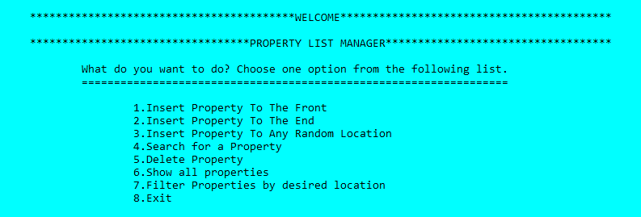
Property List Manager
insertfront()
searchProperty()
InsertRear()
deleteProperty()
InsertNext()
showProperties()
filterPropertyByLocation()

Slide 4
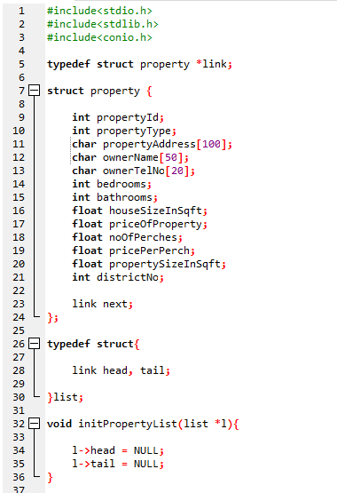

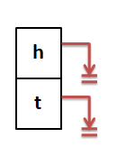
propertyAddress
priceOfProperty
ownerName
noOfPerches
ownerTelNo
pricePerPerche
bedrooms
houseSizeInSqft
l

Slide 5
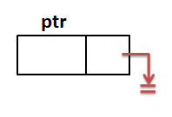
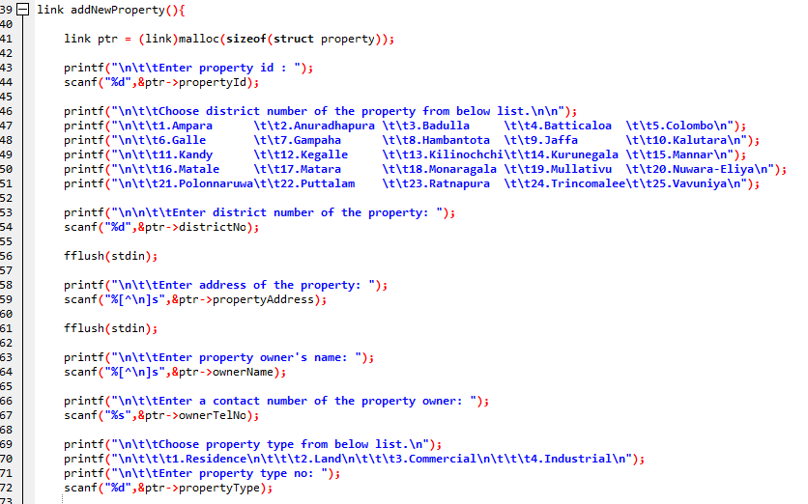

Slide 6
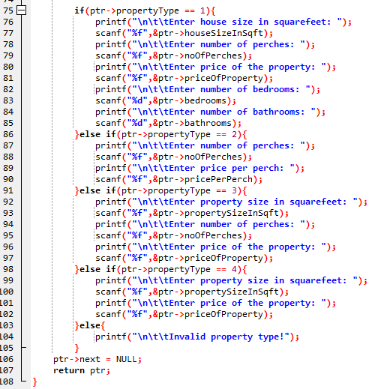
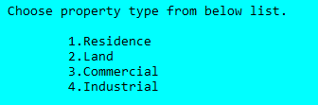

Slide 7
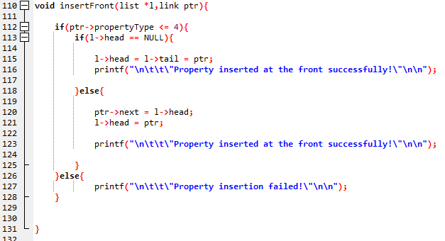
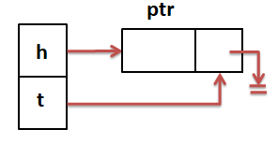
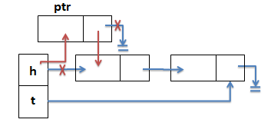


l
l
$$②$$
$$①$$

Slide 8
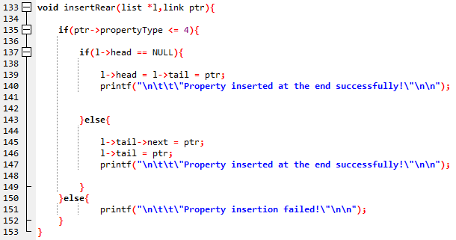
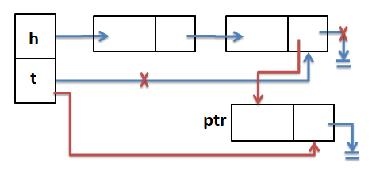


l
l
$$①$$
$$②$$

Slide 9
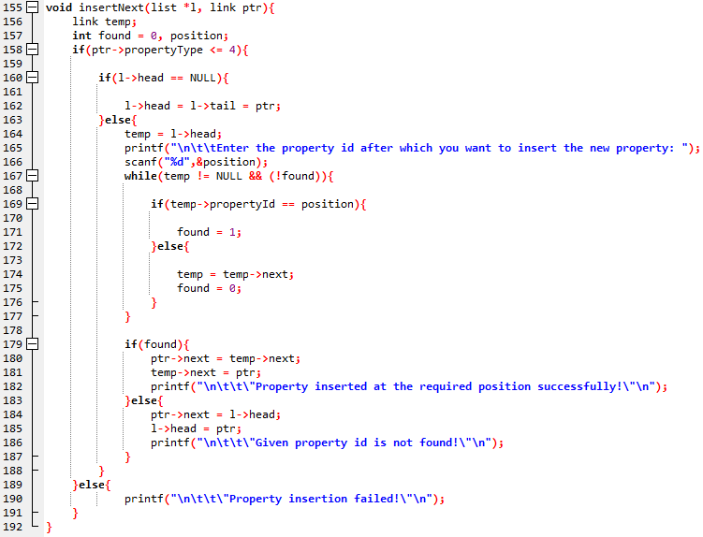
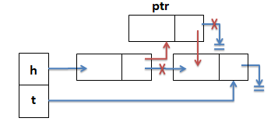


l
l
temp
$$②$$
$$①$$

Slide 10
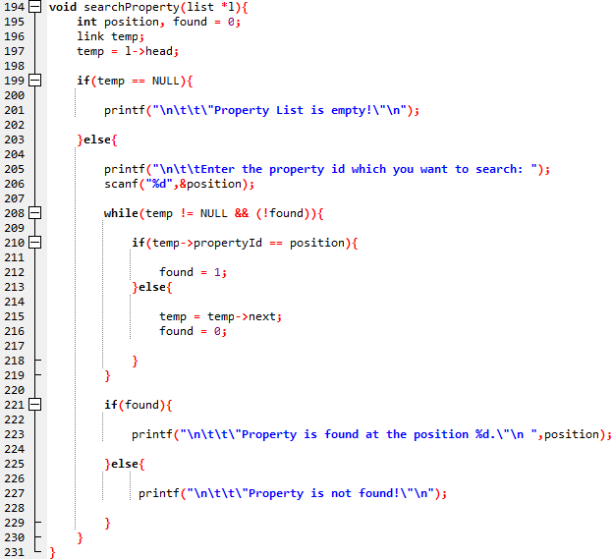

Slide 11
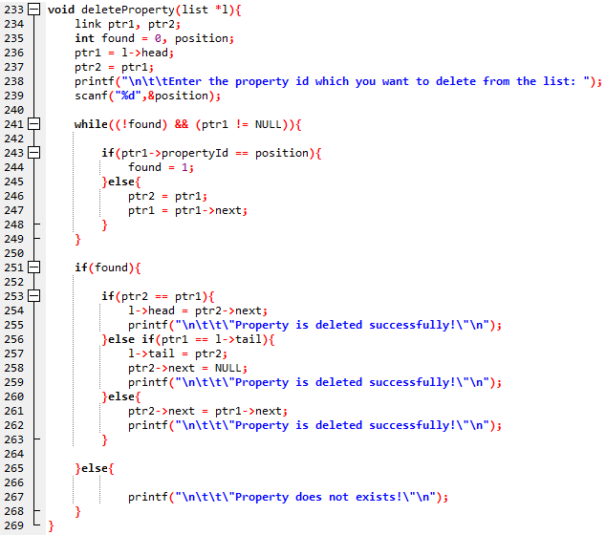
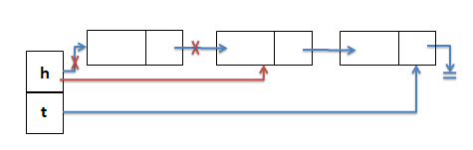
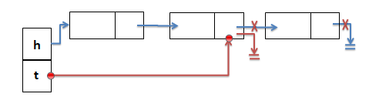
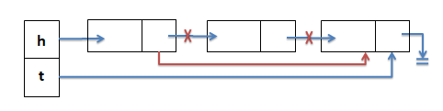
ptr2
ptr1
l
ptr2
ptr1
l
l
ptr2
ptr1

Slide 12
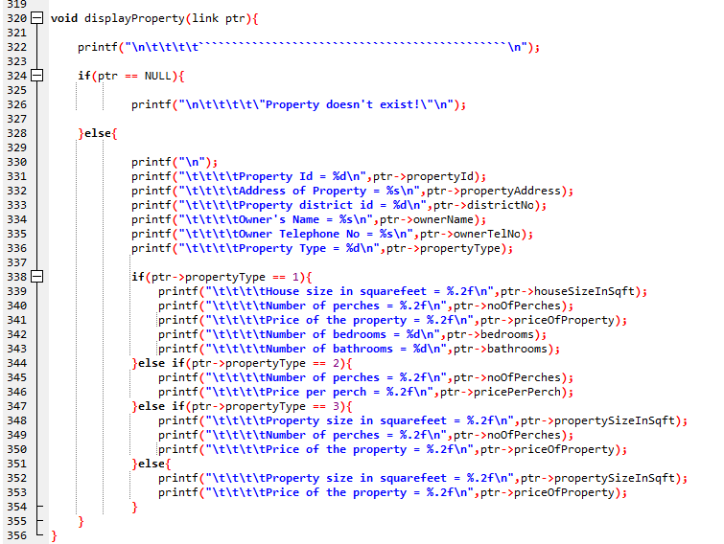

Slide 13
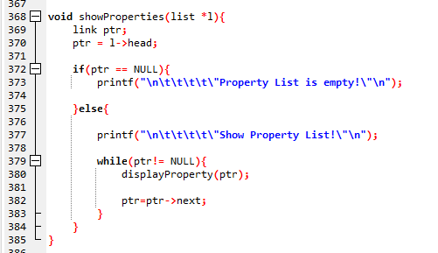
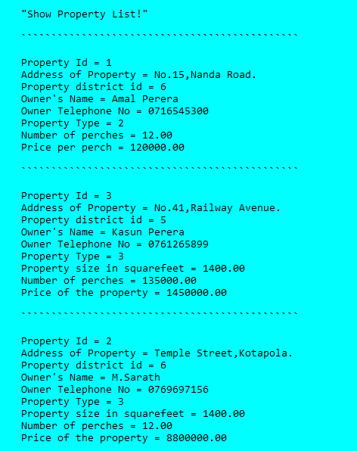

Slide 14
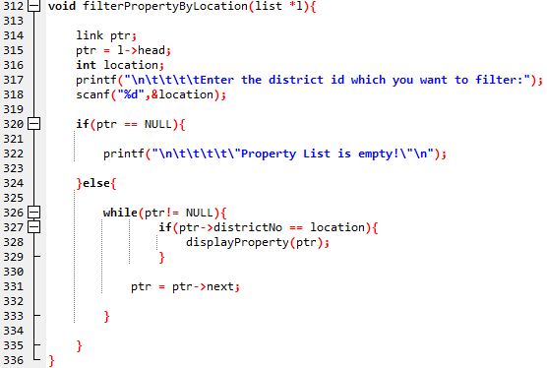
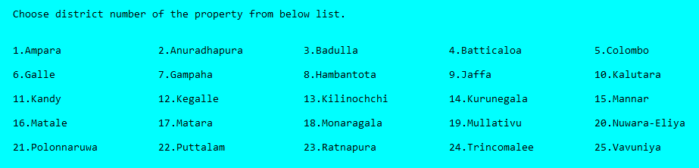

Slide 15
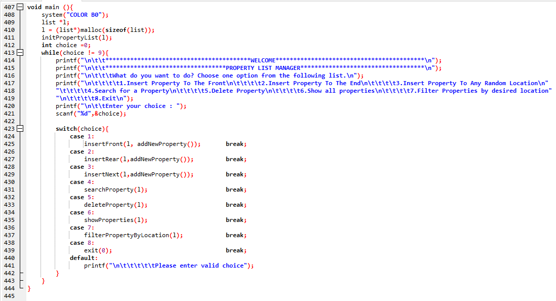

Slide 16


Slide 17
THANK YOU
Group Members :
A.A.R.D.Perera
M.L.M.Dharani
W.A.D.H.Sandunika
E.O.S.Ediriweera
N.P.L.P.Dharmarathne

